Slide 1

INTRODUCTION TO WEB DEVELOPMENT
1
Code: COMP07009
Week 6
Accessibility / Security

Slide 2
WEB ACCESSIBILITY
2

Slide 3
WAI
3
Web Accessibility Initiative
Created by W3C in 1997
Intended for web designers, developers
Purpose is to make web content accessible to people with disabilities
Main aim is about accessibility
Also helps to make web content available in more web browsers (eg smart phones, other hand-held devices)
Also to enable more users in different environments (eg strong light, bad sight, loud noise)

Slide 4
Is it important?
4
Improve your reputation and image
Improve your customer satisfaction
Increase your number of visitors
Let your visitors stay longer at your site
Make your site more usable also for people with no disabilities
Make your site more usable for users with images turned off
Make your site more usable for people with older equipment
Let you reach the fastest growing population: older people

Slide 5
Accessibility Guidelines
5
http://www.w3.org/TR/WAI-WEBCONTENT/#Guidelines
Provide equivalent alternatives to auditory and visual content.
Provide content that, when presented to the user, conveys essentially the same function or purpose as auditory or visual content.
Eg use alt attribute for <img> element

Slide 6
Accessibility Guidelines
6
2. Don’t rely on colour alone.
Ensure that text and graphics are
understandable when viewed without
colour.
Provide content that, when presented to
the user, conveys essentially the same
function or purpose as auditory or visual
content.
Eg ability to distinguish with and without
colour

Slide 7
Accessibility Guidelines
7
3. Use markup and style sheets and do so properly.
Mark up documents with the proper structural elements. Control presentation with style sheets rather than with presentation elements and attributes.
Eg don’t use tables for layout, use CSS for presentation

Slide 8
Accessibility Guidelines
8
4. Clarify natural language usage.
Use markup that facilitates pronunciation or interpretation of abbreviated or foreign text.
Eg in lang attribute in HTML can be used to declare the language of a Web page or a portion of a Web page which is meant to assist search engines and browsers.

Slide 9
Accessibility Guidelines
9
5. Create tables that transform gracefully.
Ensure that tables have necessary markup to be transformed by accessible browsers and other user agents.
Eg Tables should be used to mark up truly tabular information

Slide 10
Accessibility Guidelines
10
6. Ensure that pages featuring new technologies transform gracefully.
Ensure that pages are accessible even when newer technologies are not supported or are turned off.
Eg Organize documents so they may be read without style sheets

Slide 11
Accessibility Guidelines
11
7. Ensure user control of time-sensitive content changes.
Ensure that moving, blinking, scrolling, or auto-updating objects or pages may be paused or stopped.
Eg don’t use BLINK and MARQUEE elements

Slide 12
Accessibility Guidelines
12
8. Ensure direct accessibility of embedded user interfaces.
Ensure that the user interface follows principles of accessible design
Eg device independent access to functionality, keyboard operability, self- voicing, ensure pages are usable when applets, scripts are turned off

Slide 13
Accessibility Guidelines
13
9. Design for device-independence.
Use features that enable activation of page elements via a variety of input devices.
Eg allow user to have preferred input – mouse or keyboard

Slide 14
Accessibility Guidelines
14
10. Use interim solutions
Use interim accessibility solutions so that assistive technologies and older browsers will operate correctly.
Eg older screen readers read lists of consecutive links as one link so these are difficult or impossible to access

Slide 15
Accessibility Guidelines
15
11. Use W3C technologies and guidelines.
Provide an alternative version of the content that is accessible
Eg many non-W3C formats like Shockwave require viewing with either plug-ins or stand-alone applications

Slide 16
Accessibility Guidelines
16
12. Provide context and orientation information.
Help users understand complex pages or elements
Eg divide large blocks into groups

Slide 17
Accessibility Guidelines
17
13. Provide clear navigation mechanisms
Increase the likelihood that a person will find what they are looking for at a site
Eg navigation bar, site map

Slide 18
Accessibility Guidelines
18
14. Ensure that documents are clear and simple.
They may be more easily understood
Eg simple, consistent, intuitive

Slide 19
Examples
19
Use “alt” attribute to provide an alternative text for an image
May be slow connection, user may use screen reader
Don’t use small fonts
Cause difficulty reading the page
Avoid fancy fonts
This font is difficult to read....
Avoid poor colour contrasts
text on a blue background
Some combinations strain the eye
Set background colour
If you don’t set a background colour, the text may be invisible

Slide 20

Checking Tools
20
There are now many tools which can be used to check the
accessibility, evaluation and compliance of web sites. Many of these tools are free downloads.
Complete List of Web Accessibility Evaluation Tools
Eg AccessColor
Tests the colour contrast and colour brightness between
the foreground and background of all elements to make
sure that the contrast is high enough for people with visual impairments.
http://wave.webaim.org/
Validators for html and CSS
http://jigsaw.w3.org/css-validator
http://validator.w3.org/

Slide 21
Recommendations
21
Manually check web pages using the browser to check if text and size can be adjusted, if the site is readable when style information is removed and whether resources can be accessed without using a mouse.
Test web site using different browsers including non graphical browsers such as Lynx.
Test the web site to ensure it can be used with assistive technology such as screen readers, screen magnifiers and speech browsers.
Where possible involve people with specific requirements, in helping to test the web site.

Slide 22
22
WEB SECURITY
https://developer.mozilla.org/en-US/docs/Web/Security

Slide 23
Web Security
23
Web sites are prone to security risks
Your web site or open web application should be secure
Simple bugs in the code can result in private information being leaked
Understanding information security can help avoid leaving software and sites insecure and vulnerable to weaknesses
Vulnerabilities can be exploited for financial gain or other malicious reasons

Slide 24
Security Considerations
24
Updated Software
Any updates/patches
SQL Injection
Attempt by hackers to manipulate your database
Error Messages
Careful about how much information to be given in error messages
Validation of Data
Should be performed on both the client and server side
Passwords
Enforce requirements such as minimum of 8 characters, including
upper case, lower case and special characters
https://www.tutorialspoint.com/internet_technologies/website_security.htm

Slide 25

Security Considerations
25
Web Server
Web content is stored
Error 404 if web page is not found
Secure Socket Layer (SSL)
Encryption
Authentication
A website that is secured with a SSL certificate will display https://
before the web address

Slide 26
Protocols
26
HTTP – HyperTextTransferProtocol (Port 80)
Protocol used to send data between browser and a website
HTTPS – HyperTextTransferProtocolSecure (Port 443)
Secure protocol means that all communication ns between the browser and the website are encrypted.
Often used to protect confidential online transactions such as online banking, shopping etc.
Browsers such as Chrome and Firefox often display a padlock icon in the address bar to visually indicate a HTTPS connection is in use.

Slide 27
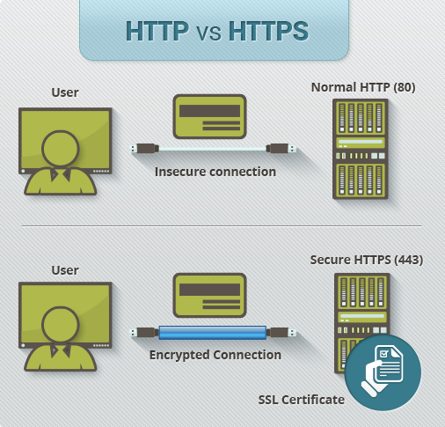
Protocols
27
Benefits of HTTPS
Information is encrypted and cannot be intercepted
Visitors can verify you are a registered business and you own the domain
Customers are more likely to trust and complete purchases from sites that use HPPPS
https://www.instantssl.com/ssl-certificate-products/https.html

Slide 28
JavaScript
28
Cross site Scripting (XSS)
Uses unreliable data and passes to the browser without appropriate validation
Common exploited web vulnerabilities
Allows attackers to inject client side script into web pages
Developers
Using 3rd party libraries
Developer tools
Users
Track user activity
Log actions

Slide 29
Lab
29
There is not a new lab this week but check that you have completed all earlier labs.
Assessment 1 is due to be uploaded to Moodle account on 25th October 2021
Make sure that you have ZIP all the files/folders and uploaded to Moodle assessment submission option.
If you have any problems , Feel free to contact at mazhar.malik@uws.ac.uk.

